Slide 1

Software Visualization
Johan van den Muijsenberg

Slide 2
Overview

Slide 3
Good Design
Naming | Complexity
Cohesion | Coupling
Notes:
Aspect Guideline Metric Visibility
Naming Names should reflect problem domain None High
Complexity Methods should have a low cyclomatic <10 High
Cohesion Modules should be small and follow the <1KLOC High
single responsibility principle
Coupling Low coupling and dependencies towards None Low
abstractions and interfaces. No cycles.

Slide 4
Lacking Visibility

Slide 5
Fact: Visualization Tools Not Used

Slide 6
As developer

Slide 7
As a developer

Slide 8
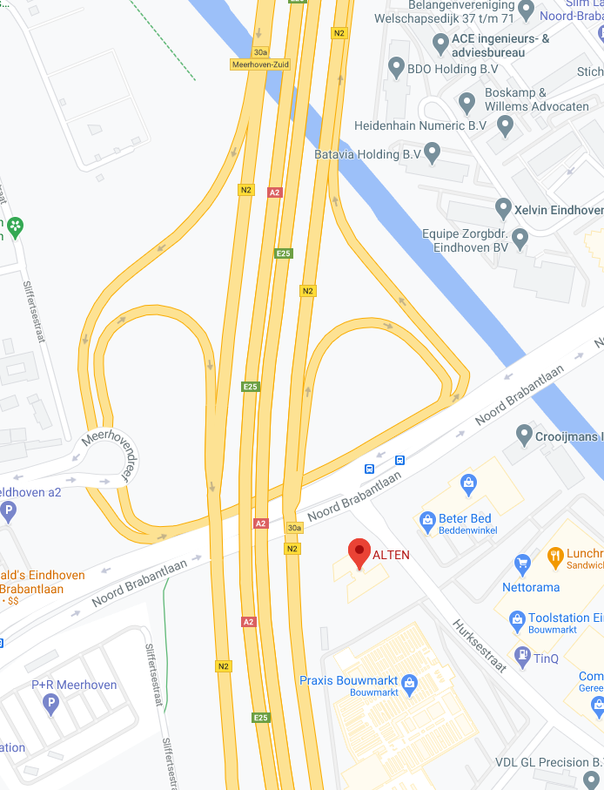
Onboarding
You are here

Slide 9
Background: Agile Manifesto
Individuals and interactions over processes and tools
Working software over comprehensive documentation
Customer collaboration over contract negotiation
Responding to change over following a plan

Slide 10
Task: Fix defect

Slide 11
Fact: Info Sys

Slide 12
Task: Implement Feature

Slide 13
Fact: 50%

Slide 14
FACT: Avoid comprehension

Slide 15
Task: Refactor NMI

Slide 16
Need: Understand Dependencies

Slide 17
As architect

Slide 18
Software Rot
Rigidity
Fragility
Immobility
Viscosity

Slide 19
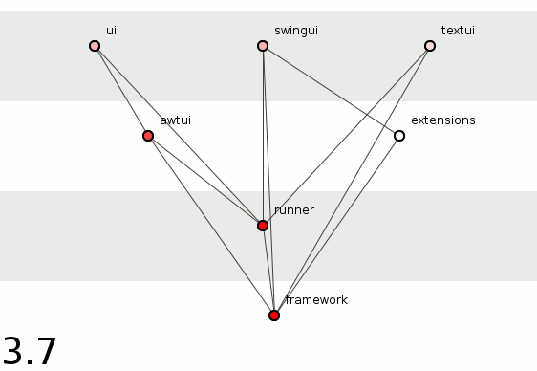

Slide 20
Need: Get feedback on arch

Slide 21
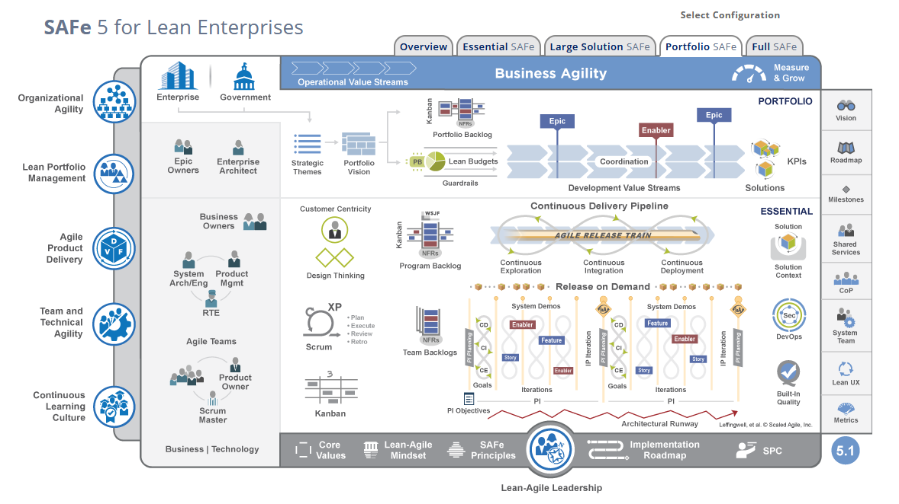

Slide 22
Intentional vs Emergent
Agile architecture balances intentionality and emergence:
Intentional architecture – Defines a set of purposeful, planned architectural strategies and initiatives, which enhance solution design, performance, and usability and provide guidance for inter-team design and implementation synchronization.
Emergent design – Provides the technical basis for a fully evolutionary and incremental implementation approach. This helps developers and designers respond to immediate user needs, allowing the design to evolve as the system is built and deployed.

Slide 23
Intentional vs Emergent: But how

Slide 24
As tester

Slide 25
Need: Integration Strategy

Slide 26
Need: Predict Defects Dep/CC

Slide 27
Fact: More Defects

Slide 28
As manager

Slide 29
Need: Out source

Slide 30
Fact: Lower productiive

Slide 31
Need: Staffing

Slide 32
Lines and Boxes

Slide 33

Notes:
UML is best known lines and boxes notation

Slide 34
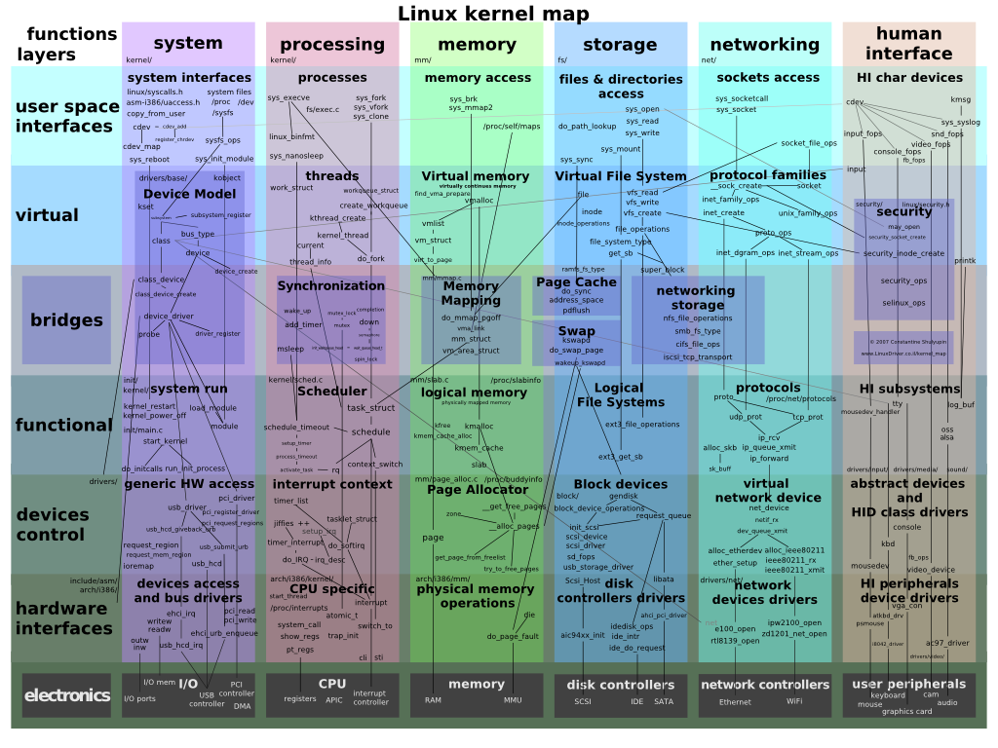
Notes:
But at some point it becomes too cluttered

Slide 35
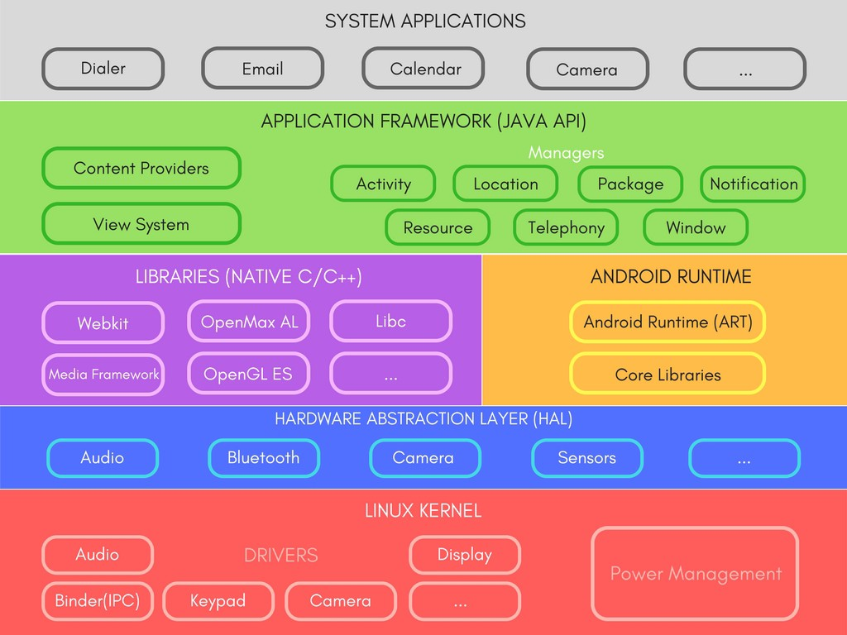
Just Boxes No Lines
Notes:
And then only boxes are shown

Slide 36
Design Structure Matrix

Slide 37
Many dependencies
Wrong direction
Skip layer
Cycle
Not used

Slide 38
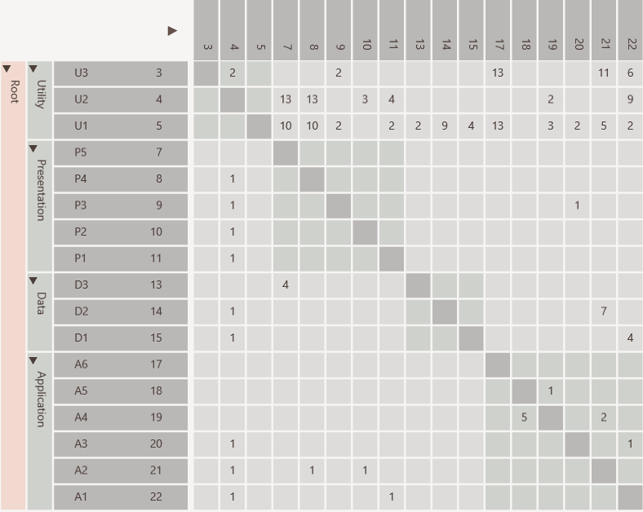
Same rows and columns
Identity line
Value indicates strength
P5 uses D3
Hierarchy

Slide 39
Dependencies from A1 to U1, U2 and U3
individually

Slide 40
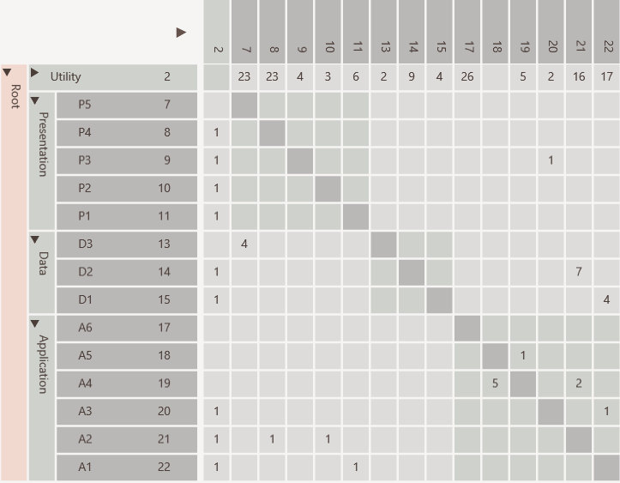
Dependencies from A1 to U1, U2 and U3
aggregated

Slide 41
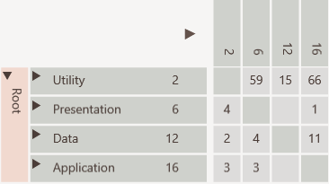
All dependencies between Application and Utility collapsed

Slide 42
Many dependencies above identity line

Slide 43
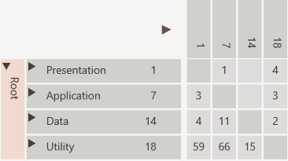
Consumers to top
Cycle easily visible
Providers to bottom

Slide 44
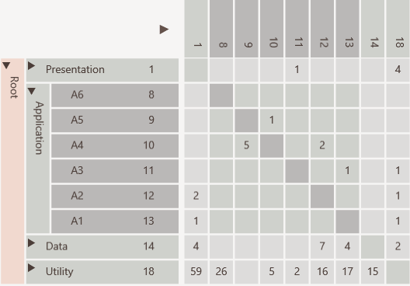
Not used
Encapsulated
Public interface
Encapsulation Pattern

Slide 45
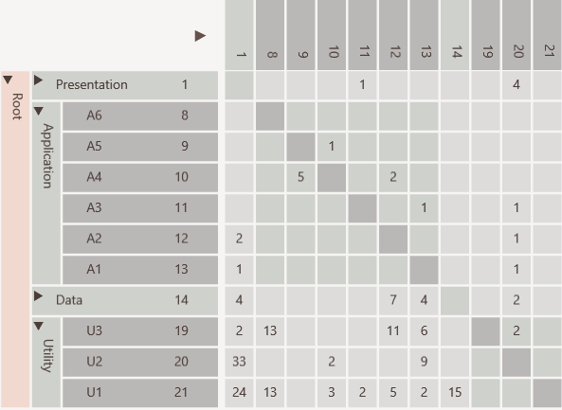
Elements used in entire software like utilities and data access objects
Bus/Utility Pattern

Slide 46
U2 has many in and out going dependencies
Change Propagator Pattern

Slide 47
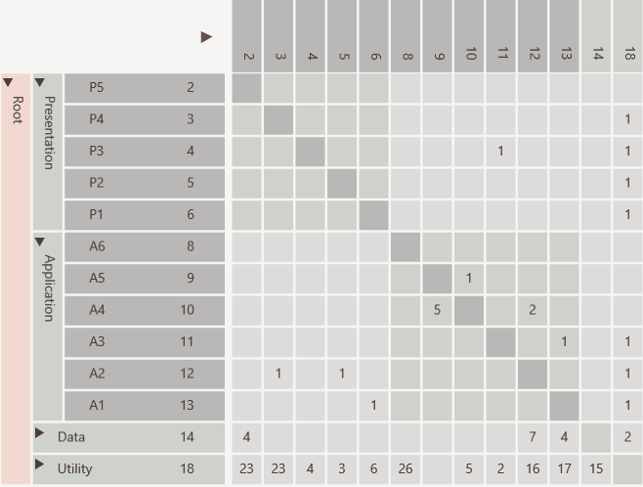
Hierarchical cycle due to
A3 using P3
which violates layering
Before

Slide 48
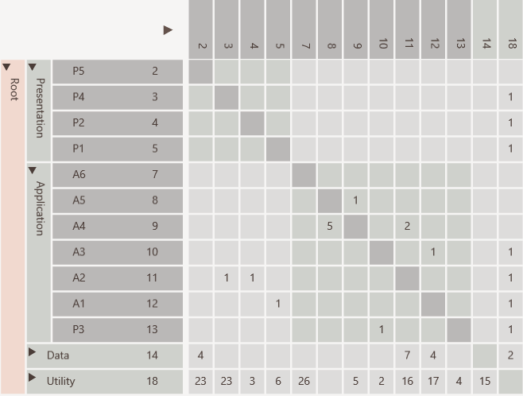
Cycle removed by moving P3
After

Slide 49
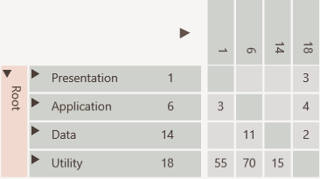

Slide 50
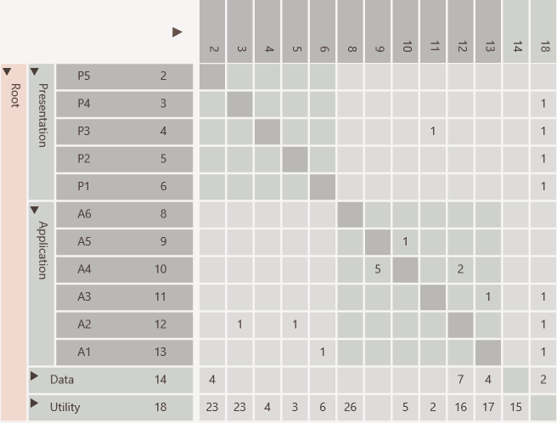
Hierarchical Cycle
Cycle removed by moving P3
Cycle removed by moving P3
System Cycle

Slide 51
Tools

Slide 52
Programming
Language
Checks
Design
Metrics
Dependency
Visualization

Slide 53
DsmSuite

Slide 54
Comparer
Analyzer
Compares
Analyzer
Analyzer
Analyzer
DSI
file
Viewer
DSM
file
Analyzer
Exports
Imports
Visualizes
.Net, Java, C++, Visual Studio and UML
Conforms To
dsi.xsd
Third Party Analyzer

Slide 55
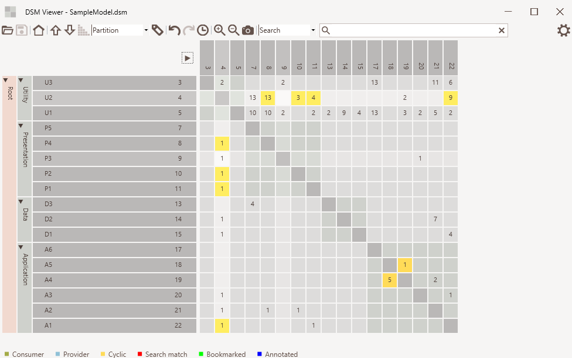
Cell
selected
Element Hierarchy
Cell
hovered

Slide 56
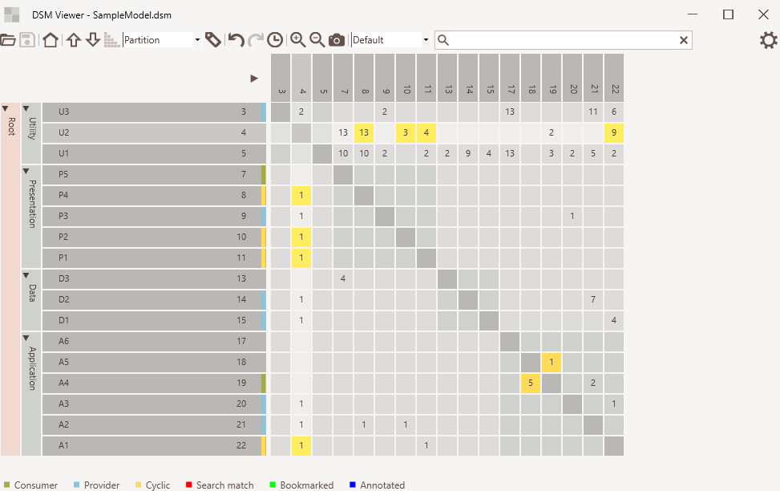
Default mode
Consumer/provider indicators
Normal dependency
Cyclic dependency

Slide 57
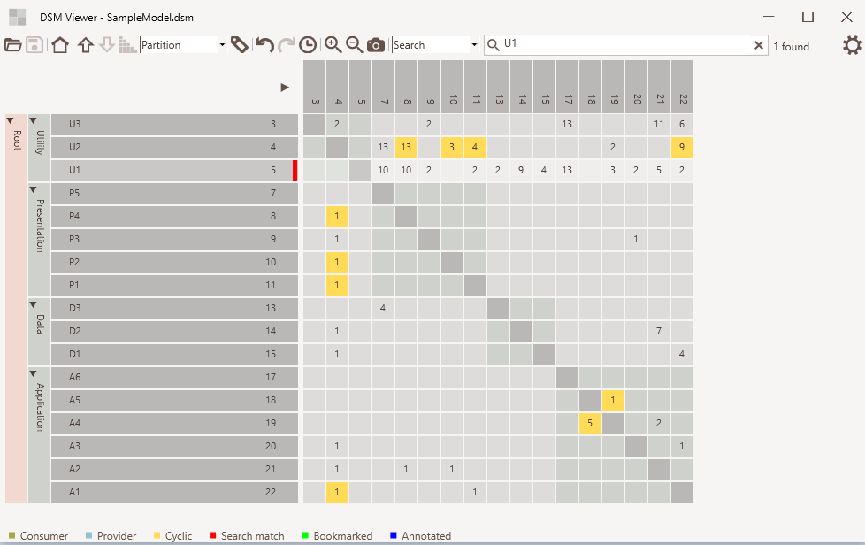
Search mode
Search text
Elements found
Match indicator

Slide 58
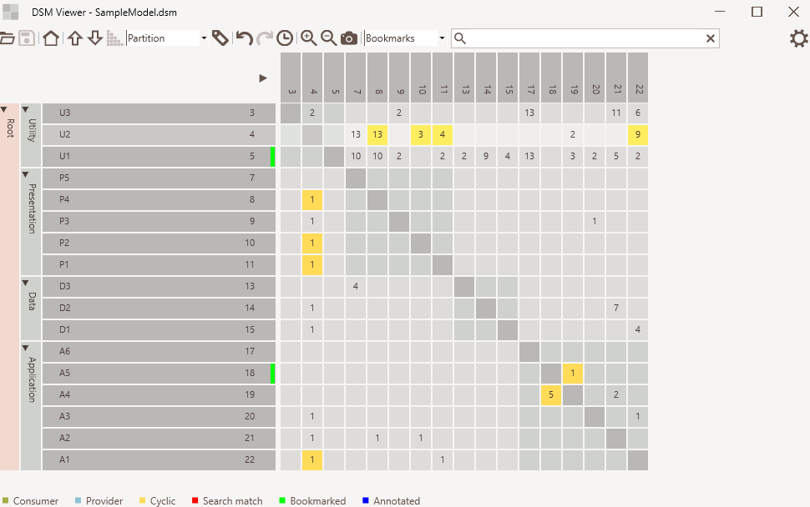
Bookmark mode
Bookmarked
indicator

Slide 59
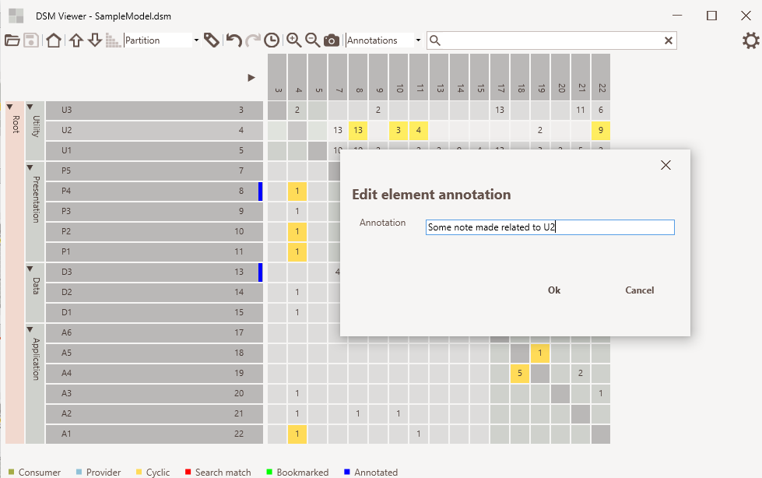
Annotation mode
Annotated
indicator

Slide 60
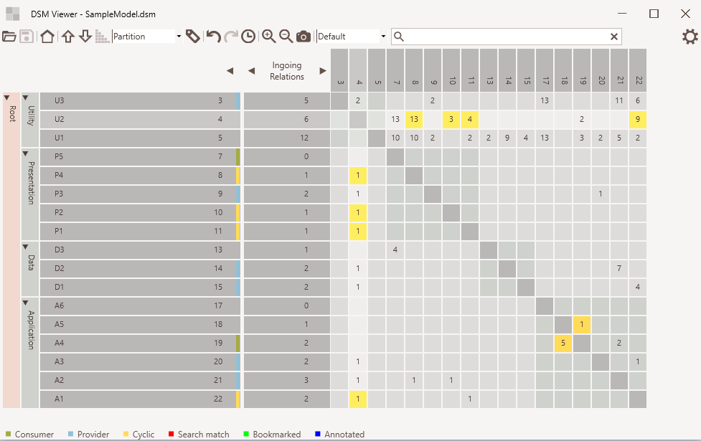
Expand / collapse
Metrics selection
Metrics values

Slide 61
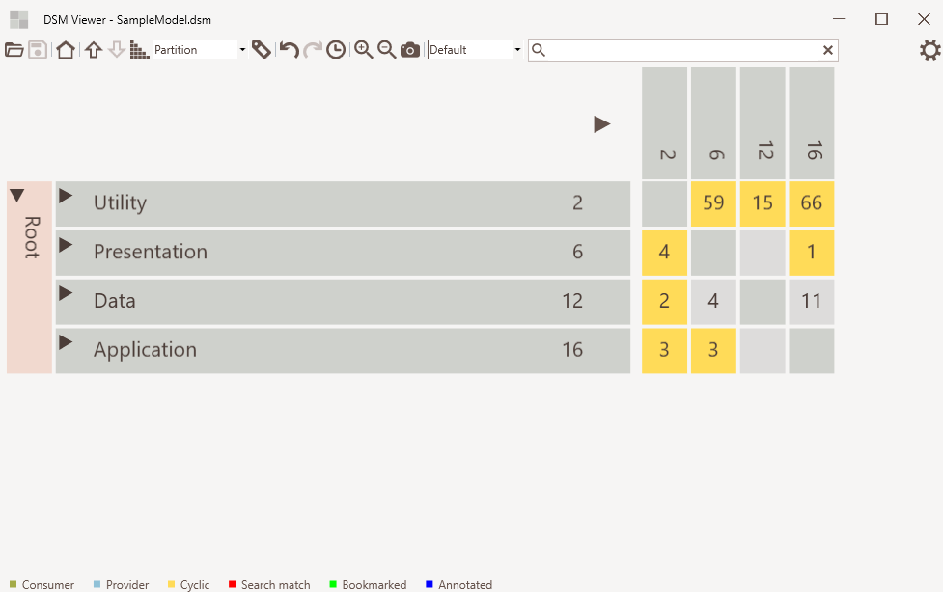
Zoom in/out
Screenshot

Slide 62
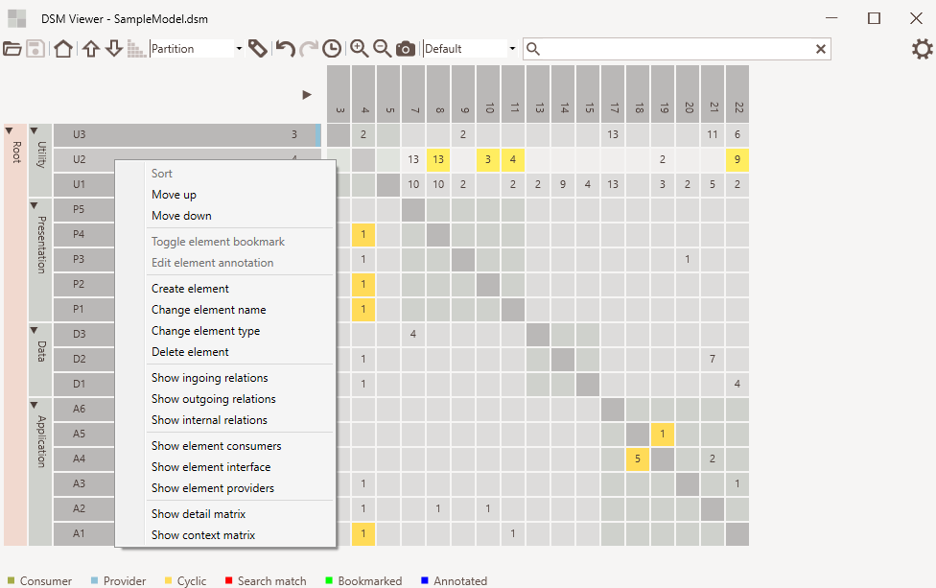
Element context menu

Slide 63
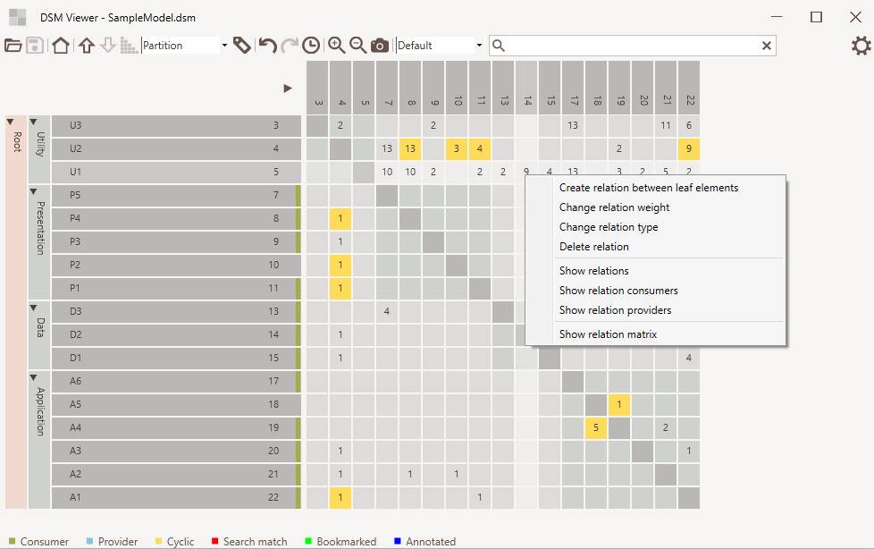
Relation context menu

Slide 64
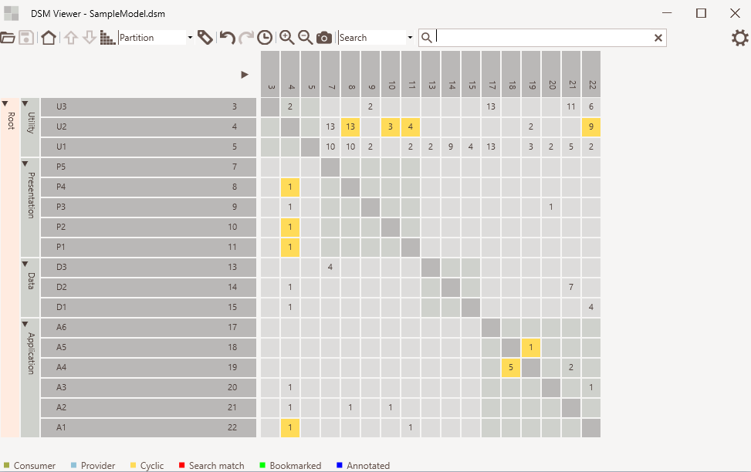
Move up/down
Sort
Undo/redo and history
Move element using drag and drop
Edit relation using cell context menu
Edit element using cell context menu

Slide 65
Enterprise Architect

Slide 66
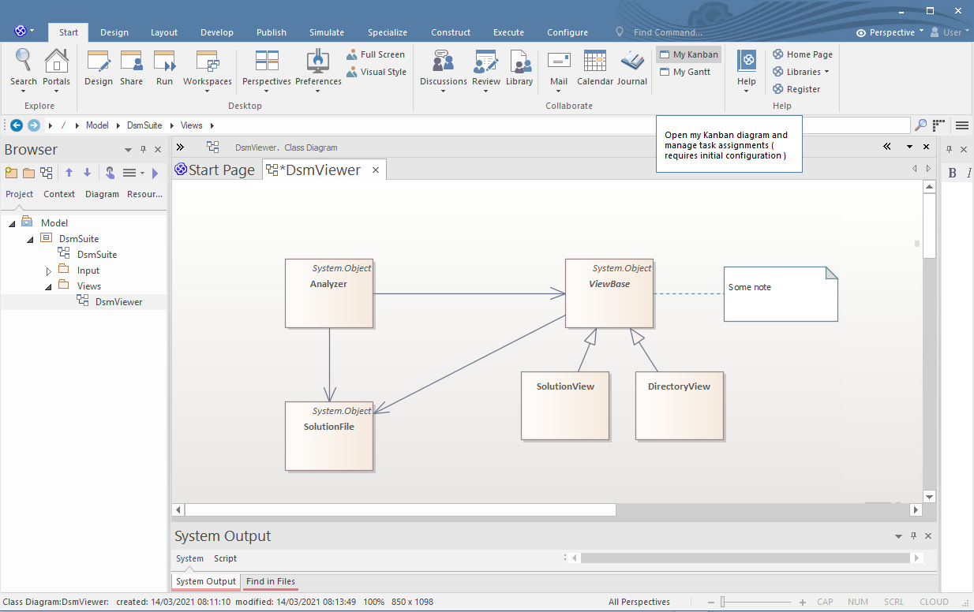
Three categories overlap

Slide 67
Understand

Slide 68
Three categories overlap

Slide 69
CppDepend

Slide 70
Three categories overlap

Slide 71
Structure101

Slide 72
Three categories overlap

Slide 73
Lattix

Slide 74
Three categories overlap

Slide 75
Does it pay off

Slide 76
Conclusions

Slide 77
Intro

Slide 78
Intro

Slide 79
Intro

Slide 80
Intro

